Slide 1

Statistical Evaluation for Methods of Gene-set Analysis with Multivariate Non-normal Scenarios
Speaker: CHI-HSUAN HO
Advisor: Chuhsing Kate Hsiao

Slide 2
Outline
Introduction
Background
Motivation
The Non-normality of Real Data
Real Data Processing
The Normality test
Results
A Statistical Evaluation for GSA Methods
Settings of Scenarios
GSA tools
Results
Summary & Discussion
Summary
Discussion
Reference

Slide 3
Introduction

Slide 4
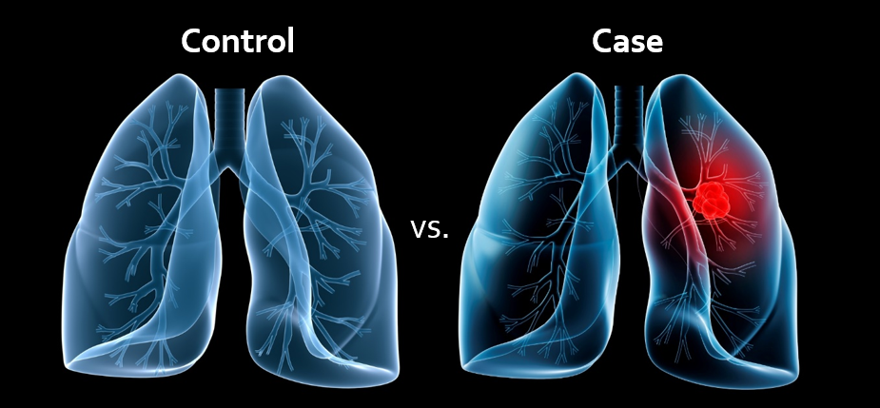


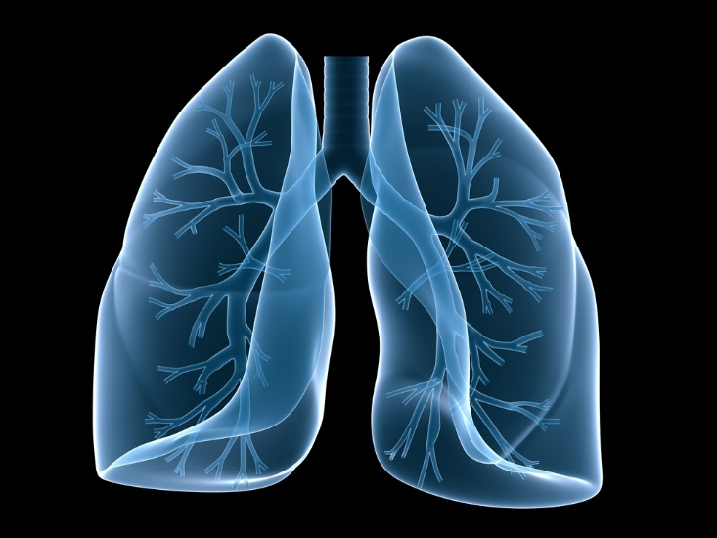
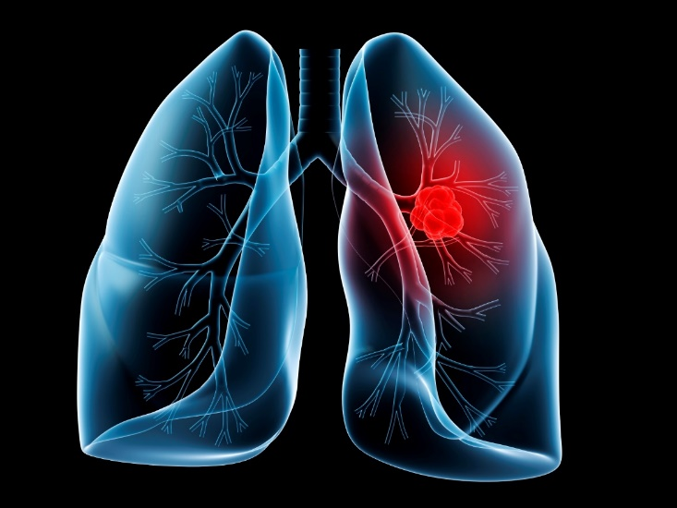

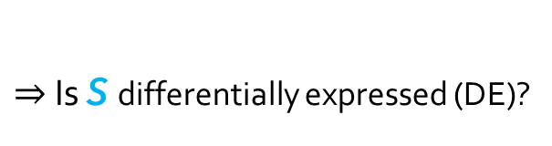
Background
Gene-set Analysis (GSA)
Pathway analysis
Testing the significance of sets of genes
Inference for the disease
Self-contained test
Control Case
Candidate
pathway or
gene set S
vs.
$$⇔$$
Is S differentially expressed (DE)?
Control Case
vs.

Slide 5
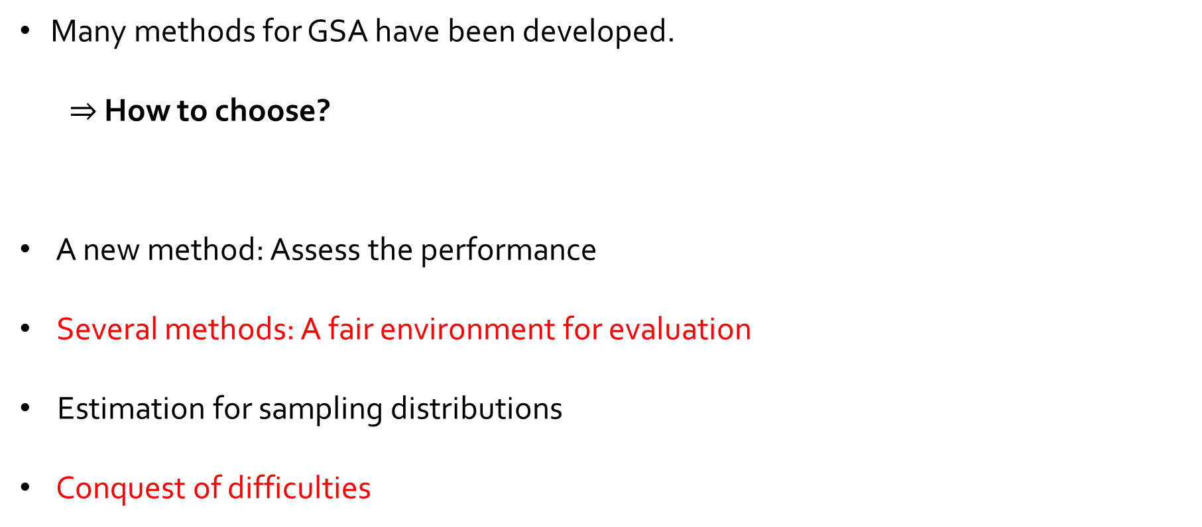
Background
Many methods for GSA have been developed.
$⇒$ How to choose?
A new method: Assess the performance
Several methods: A fair environment for evaluation
Estimation for sampling distributions
Conquest of difficulties
The functions of simulation

Slide 6

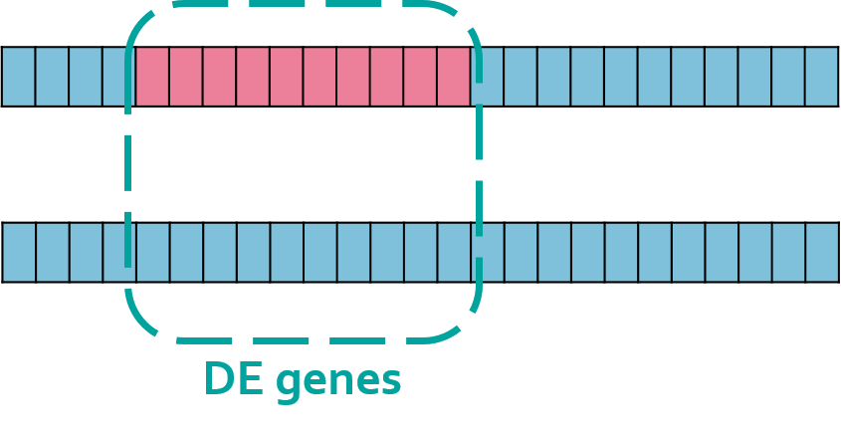
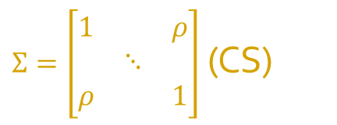
Background
Simulation methods used in current GSA
$Σ=\left[\begin{matrix}1 & & ρ \\ & ⋱ & \\ ρ & & 1\end{matrix}\right]$ (CS)
Multivariate
Normal (MVN)
Pros: Avoid the influence of normalization
Cons: The same as multivariate normal
Pros: The simplest
Cons: Inefficiency
e.g. Fixed skewness and Kurtosis
Simulation
Log-Multivariate
Normal
Real Data
Pros: Keep most of the real gene structure
Cons: The influence of the environment and other confounders
on genes are not the same for everyone

Slide 7
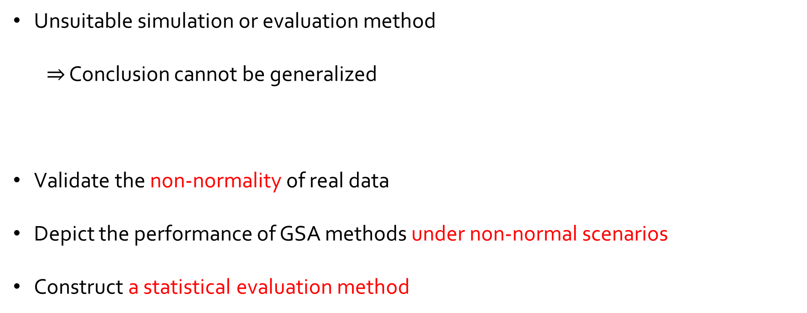
Motivation
Unsuitable simulation or evaluation method
$⇒$ Conclusion cannot be generalized
Validate the non-normality of real data
Depict the performance of GSA methods under non-normal scenarios
Construct a statistical evaluation method
The goal of this thesis

Slide 8
The Non-normality of Real Data

Slide 9

The Non-normality of Real Data
Data processing
Quantile Normalization
Raw Data (NCBI GEO/TCGA)
RMA (Robust Multi-array Average)
Disease-related Pathways Data Selection (GSA)
Homogeneous Clinical Data Management
Colorectal Cancer
Ovarian Cancer
CS/ADJ
Size: 11
Pathway: 5
Wnt
RAS
PI3K-AKT
P53
TGF-$β$
CS/CN
Size:47/116
Pathway: 4
PI3K-Akt
mTOR
Jak-STAT
p53

Slide 10

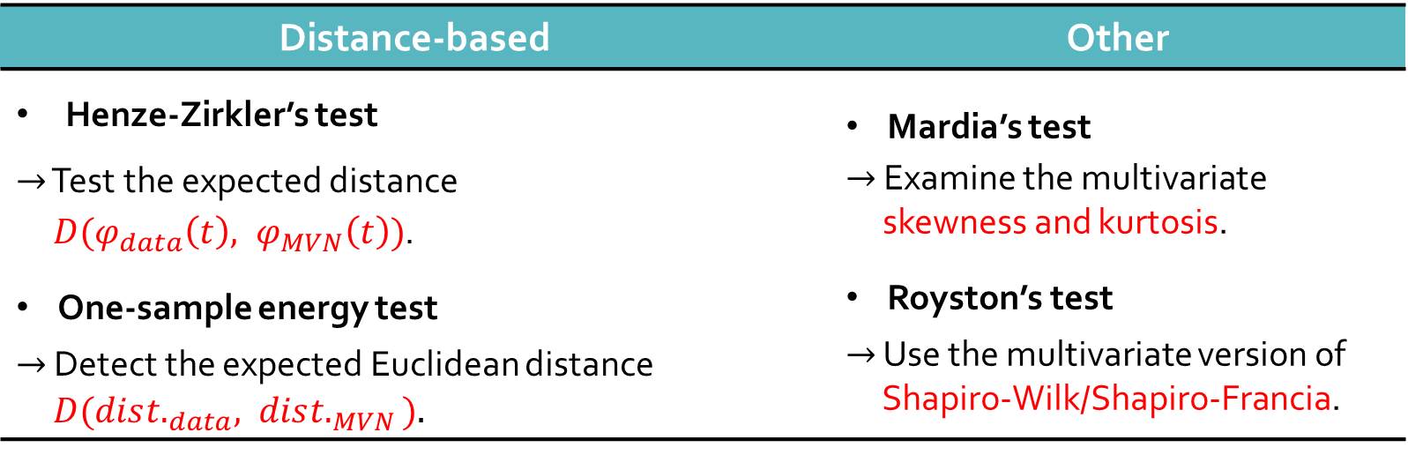
The Non-normality of Real Data
The normality test
$H_{0}:$Data are normally distributed.
Problem: Singular matrix ($p$ > $n$)
$⇒$ Sample 4 genes from each pathway to test (repeat 500 times)
Distance-based | Other
Henze-Zirkler’s test $→$ Test the expected distance $D(φ_{data}\left(t\right), φ_{MVN}\left(t\right))$. One-sample energy test $→$ Detect the expected Euclidean distance $D(dis{t.}_{data}, dis{t.}_{MVN})$. | Mardia’s test $→$ Examine the multivariate skewness and kurtosis. Royston’s test $→$ Use the multivariate version of Shapiro-Wilk/Shapiro-Francia.

Slide 11
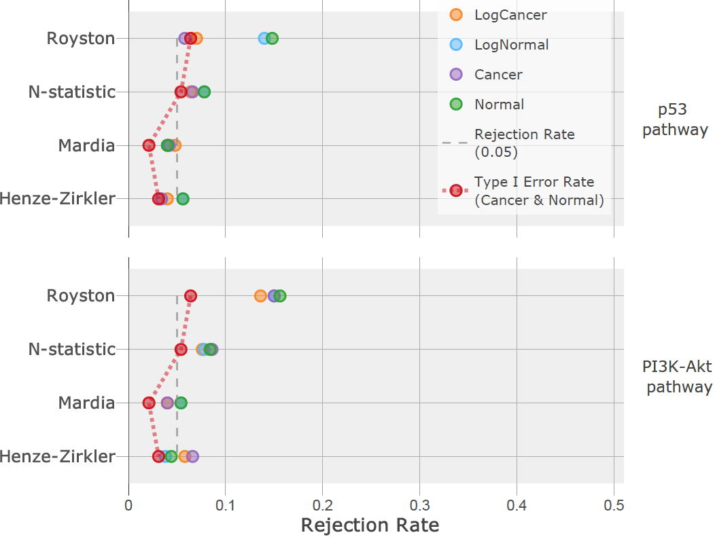
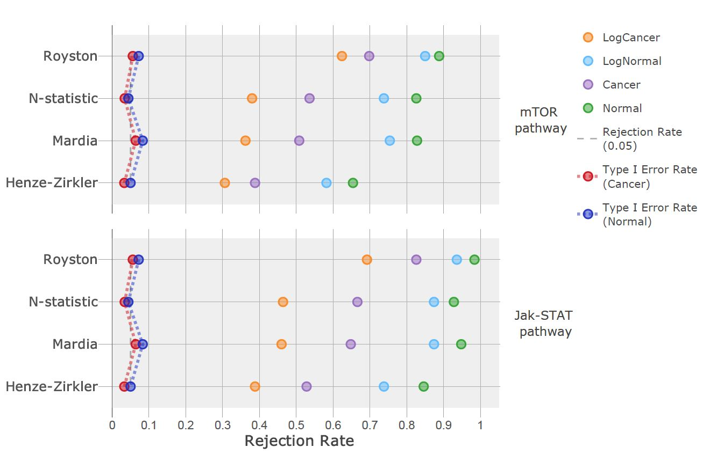
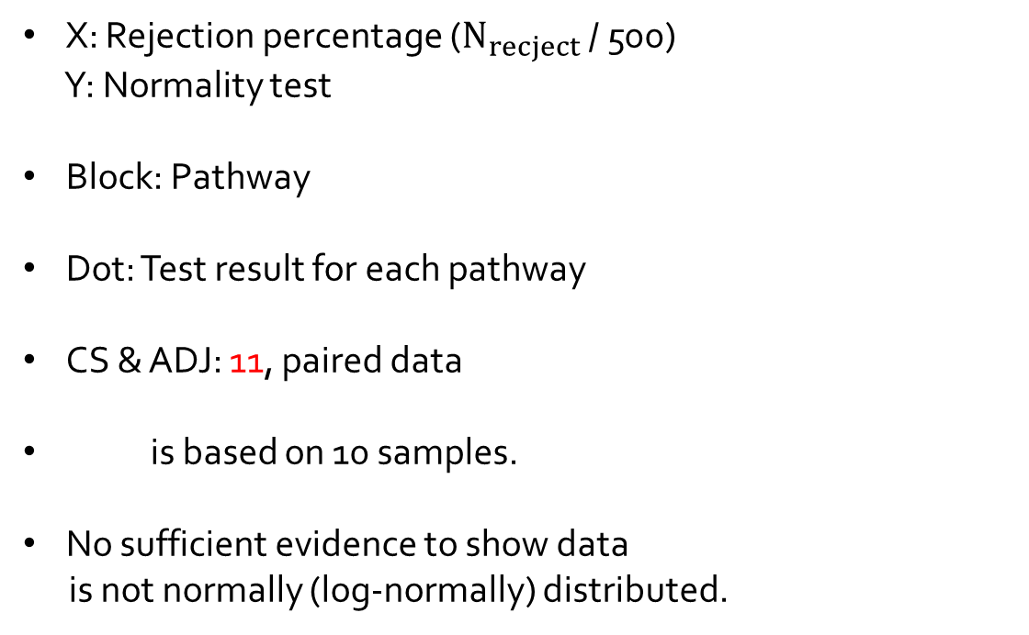
The Non-normality of Real Data
Colorectal cancer data result
X: Rejection percentage ($N_{recject}$ / 500)
Y: Normality test
Block: Pathway
Dot: Test result for each pathway
CS & ADJ: 11, paired data
is based on 10 samples.
No sufficient evidence to show data
is not normally (log-normally) distributed.

Slide 12
The Non-normality of Real Data
Ovarian cancer data result
CS: 47, CN: 116
is based on 50 samples.
is based on 100 samples.
Data is not normally (log-normally)
distributed.

Slide 13
A Statistical Evaluation for GSA Methods

Slide 14




A Statistical Evaluation for GSA Methods
Settings of Scenarios:
Scenario I, II: MVN (multivariate normal distribution)
$Control: N_{30}\left(0 , Σ=\left[\begin{matrix}\begin{matrix}1 & \\ & 1\end{matrix} & ρ_{i,j} \\ & \begin{matrix}⋱ & \\ & 1\end{matrix}\end{matrix}\right]\right), Case: N_{30}\left(Δ , Σ=\left[\begin{matrix}\begin{matrix}1 & \\ & 1\end{matrix} & ρ_{i,j} \\ & \begin{matrix}⋱ & \\ & 1\end{matrix}\end{matrix}\right]\right)$
Scenario III: MVT (multivariate t-distribution)
$Control: t_{3}\left(μ^{′}=0 , Σ^{′}=\left[\begin{matrix}\begin{matrix}1 & \\ & 1\end{matrix} & 0.9 \\ & \begin{matrix}⋱ & \\ & 1\end{matrix}\end{matrix}\right]\right), Case: t_{3}\left(μ′=Δ , Σ′=\left[\begin{matrix}\begin{matrix}1 & \\ & 1\end{matrix} & 0.9 \\ & \begin{matrix}⋱ & \\ & 1\end{matrix}\end{matrix}\right]\right)$
I. $ρ_{i,j}=0.1$
II. $ρ_{i,j}=0.9$
III. $ρ_{i,j}=0.9$

Slide 15
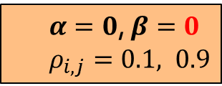

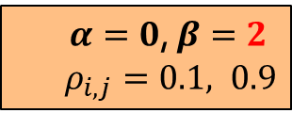
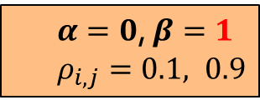
A Statistical Evaluation for GSA Methods
Settings of Scenarios:
Scenario IV, V, VI: Mix of MVN (mixture of multivariate normal distribution)
$Control: \frac{1}{2}·N_{30}\left(μ=α , Σ=\left[\begin{matrix}\begin{matrix}1 & \\ & 1\end{matrix} & 0.1 \\ & \begin{matrix}⋱ & \\ & 1\end{matrix}\end{matrix}\right]\right)+$ $\frac{1}{2}·N_{30}\left(μ=β , Σ=\left[\begin{matrix}\begin{matrix}1 & \\ & 1\end{matrix} & 0.9 \\ & \begin{matrix}⋱ & \\ & 1\end{matrix}\end{matrix}\right]\right)$
$Case: \frac{1}{2}·N_{30}\left(μ=α+Δ, Σ=\left[\begin{matrix}\begin{matrix}1 & \\ & 1\end{matrix} & 0.1 \\ & \begin{matrix}⋱ & \\ & 1\end{matrix}\end{matrix}\right]\right)+$ $\frac{1}{2}·N_{30}\left(μ=β+Δ, Σ=\left[\begin{matrix}\begin{matrix}1 & \\ & 1\end{matrix} & 0.9 \\ & \begin{matrix}⋱ & \\ & 1\end{matrix}\end{matrix}\right]\right)$
$α=0$, $β=0$
$ρ_{i,j}=0.1, 0.9$
$α=0$, $β=1$
$ρ_{i,j}=0.1, 0.9$
$α=0$, $β=2$
$ρ_{i,j}=0.1, 0.9$
IV.
V.
VI.

Slide 16
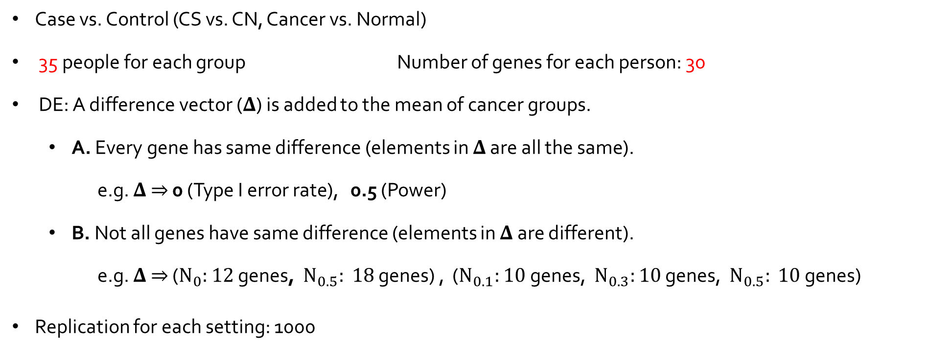



A Statistical Evaluation for GSA Methods
Settings of Scenarios:
Case vs. Control (CS vs. CN, Cancer vs. Normal)
35 people for each group Number of genes for each person: 30
DE: A difference vector ($Δ$) is added to the mean of cancer groups.
A. Every gene has same difference (elements in $Δ$ are all the same).
e.g. $Δ$ $⇒$ 0 (Type I error rate), 0.5 (Power)
B. Not all genes have same difference (elements in $Δ$ are different).
e.g. $Δ$ $⇒$ ($N_{0}:$ $12$ genes, $N_{0.5}:$ $18$ genes) , ($N_{0.1}:$ $10$ genes, $N_{0.3}:$ $10$ genes, $N_{0.5}:$ $10$ genes)
Replication for each setting: 1000
$$Δ=0$$
$$Δ=0.1, 0.2, …$$
$$Δ=\left(N_{0}:12, N_{0.5}:18\right), …$$

Slide 17
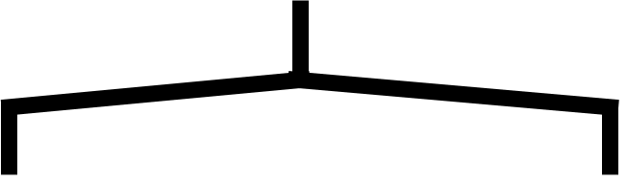


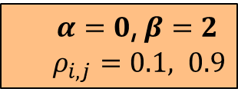

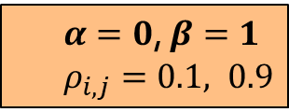


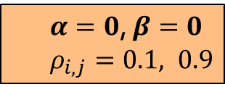

A Statistical Evaluation for GSA Methods
Evaluation Procedure:
Single Dist.
Mixture Dist.
MVN
MVT
Mixture of two MVNs
$α=0$, $β=0$
$ρ_{i,j}=0.1, 0.9$
$α=0$, $β=1$
$ρ_{i,j}=0.1, 0.9$
$α=0$, $β=2$
$ρ_{i,j}=0.1, 0.9$
I. $ρ_{i,j}=0.1$
II. $ρ_{i,j}=0.9$
III. $ρ_{i,j}=0.9$
IV.
V.
VI.
$$Δ=0$$
$$Δ=0.1, 0.2, …$$
$$Δ=\left(N_{0}:12, N_{0.5}:18\right), …$$
Five GSA Methods
Robustness

Slide 18
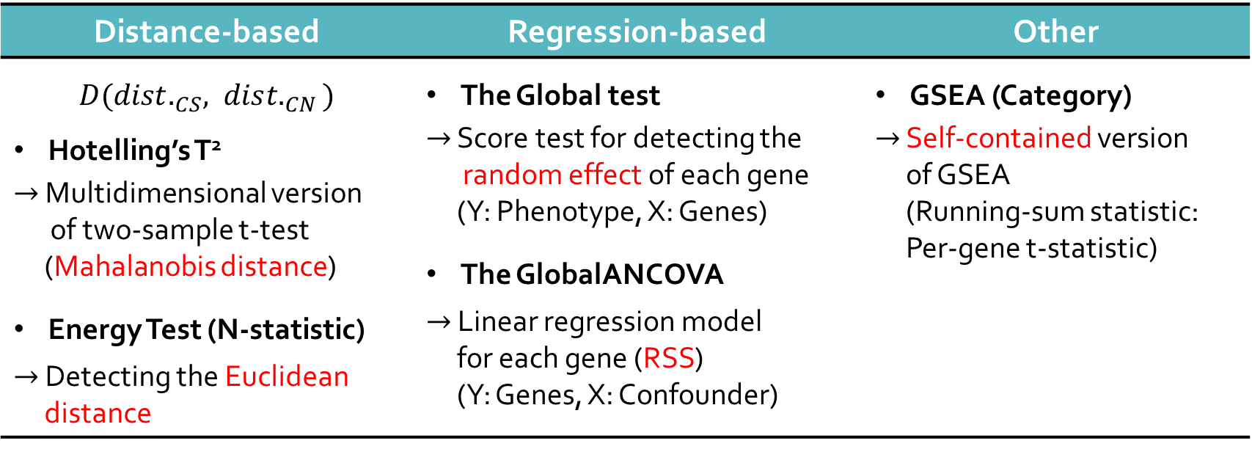

A Statistical Evaluation for GSA Methods
GSA methods:
$H_{0}：$No difference between the distributions/mean vector of the two phenotypes.
p-value: 1000 permutations
Distance-based | Regression-based | Other
$D({dist.}_{CS}, dis{t.}_{CN})$ Hotelling’s T² $→$ Multidimensional version of two-sample t-test (Mahalanobis distance) Energy Test (N-statistic) $→$ Detecting the Euclidean distance | The Global test $→$ Score test for detecting the random effect of each gene (Y: Phenotype, X: Genes) The GlobalANCOVA $→$ Linear regression model for each gene (RSS) (Y: Genes, X: Confounder) | GSEA (Category) $→$ Self-contained version of GSEA (Running-sum statistic: Per-gene t-statistic)

Slide 19
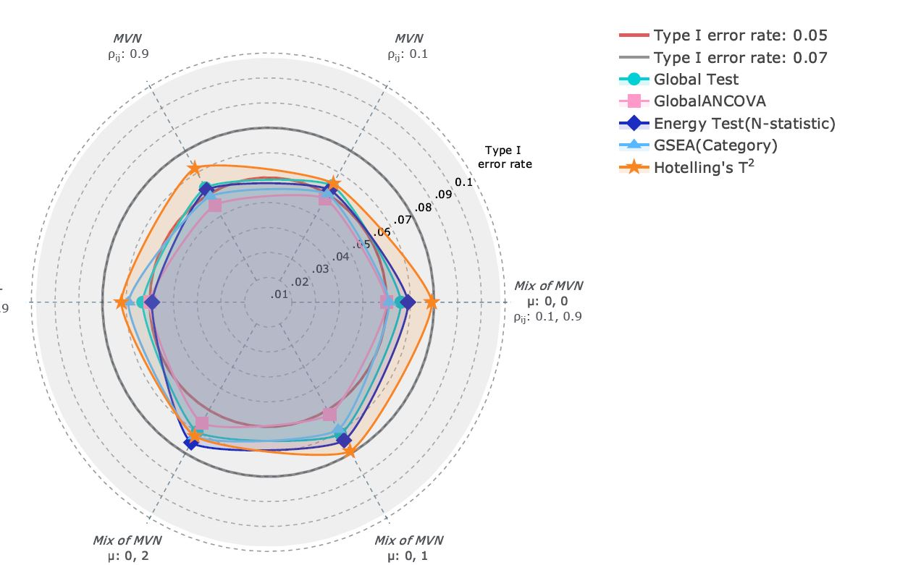
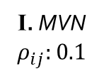
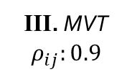

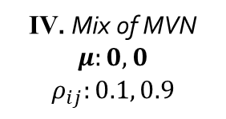



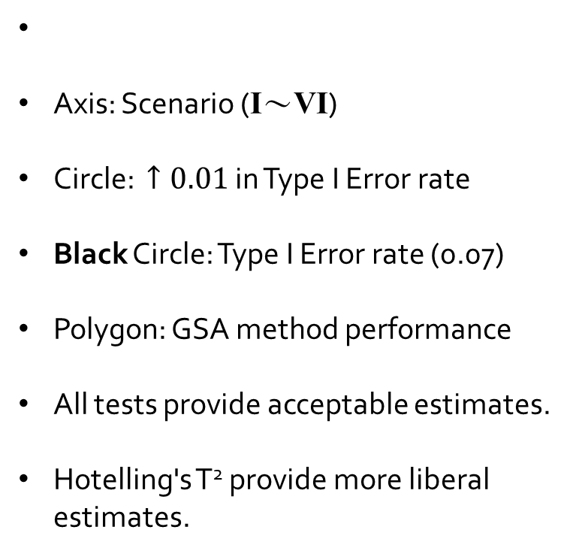
Type I Error Rate Performance
I. MVN
$$ρ_{ij}:0.1$$
$$Δ=0$$
II. MVN
$$ρ_{ij}:0.9$$
Axis: Scenario (I～VI)
Circle: $↑0.01$ in Type I Error rate
Black Circle: Type I Error rate (0.07)
Polygon: GSA method performance
All tests provide acceptable estimates.
Hotelling's T² provide more liberal estimates.
Type I Error Rate
0
III. MVT
$$ρ_{ij}:0.9$$
IV. Mix of MVN
$$μ:0, 0$$
$$ρ_{ij}:0.1, 0.9$$
VI. Mix of MVN
$$μ:0, 2$$
$$ρ_{ij}:0.1, 0.9$$
V. Mix of MVN
$$μ:0, 1$$
$$ρ_{ij}:0.1, 0.9$$

Slide 20
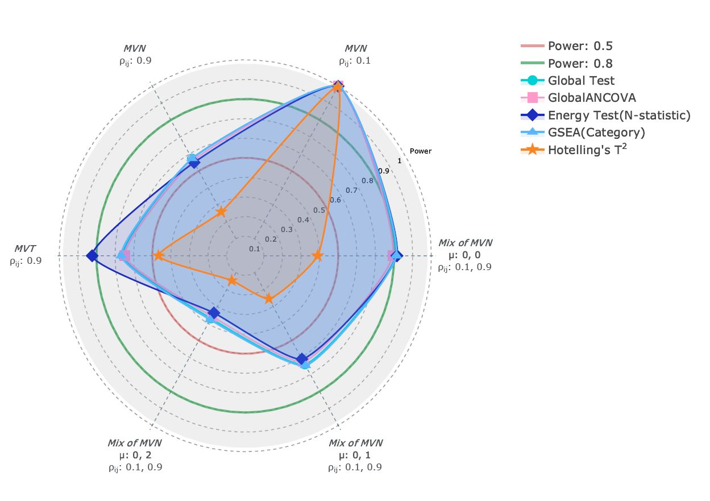


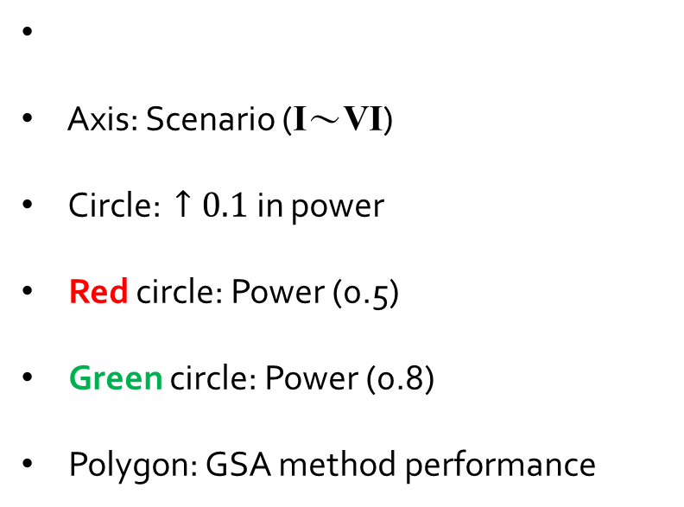
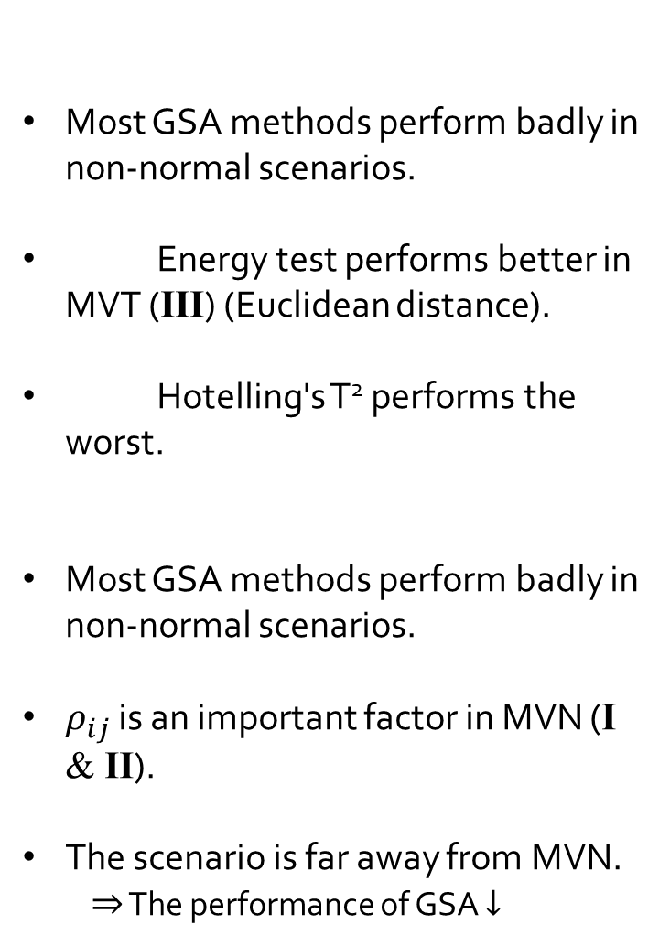

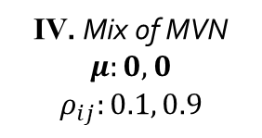
Power Performance
I. MVN
$$ρ_{ij}:0.1$$
$$Δ=0.1, 0.2,…,0.5,…$$
II. MVN
$$ρ_{ij}:0.9$$
Axis: Scenario (I～VI)
Circle: $↑0.1$ in power
Red circle: Power (0.5)
Green circle: Power (0.8)
Polygon: GSA method performance
Power
III. MVT
$$ρ_{ij}:0.9$$
IV. Mix of MVN
$$μ:0, 0$$
$$ρ_{ij}:0.1, 0.9$$
VI. Mix of MVN
$$μ:0, 2$$
$$ρ_{ij}:0.1, 0.9$$
V. Mix of MVN
$$μ:0, 1$$
$$ρ_{ij}:0.1, 0.9$$
Most GSA methods perform badly in non-normal scenarios.
Energy test performs better in MVT (III) (Euclidean distance).
Hotelling's T² performs the worst.
Most GSA methods perform badly in non-normal scenarios.
$ρ_{ij}$ is an important factor in MVN (I & II).
The scenario is far away from MVN.
$⇒$ The performance of GSA $↓$

Slide 21

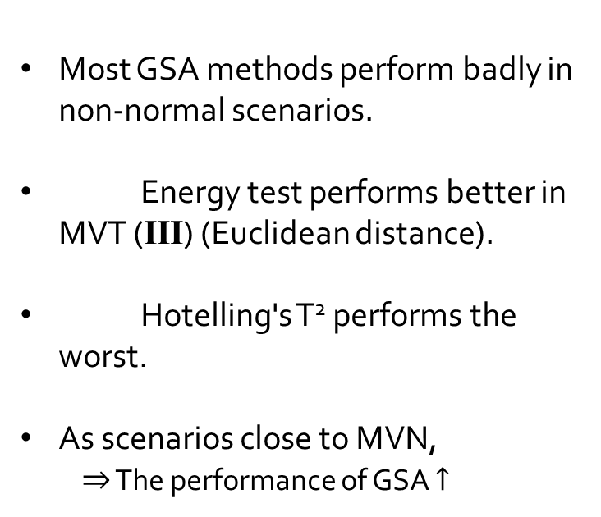
Power Performance
Most GSA methods perform badly in non-normal scenarios.
Energy test performs better in MVT (III) (Euclidean distance).
Hotelling's T² performs the worst.
As scenarios close to MVN,
$⇒$ The performance of GSA $↑$
II. MVN
$$ρ_{ij}:0.9$$
I. MVN
$$ρ_{ij}:0.1$$
Power
III. MVT
$$ρ_{ij}:0.9$$
IV. Mix of MVN
$$μ:0, 0$$
$$ρ_{ij}:0.1, 0.9$$
VI. Mix of MVN
$$μ:0, 2$$
$$ρ_{ij}:0.1, 0.9$$
V. Mix of MVN
$$μ:0, 1$$
$$ρ_{ij}:0.1, 0.9$$

Slide 22
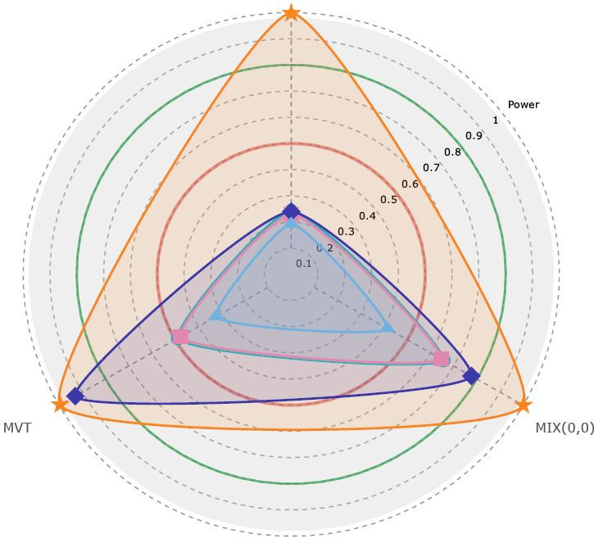

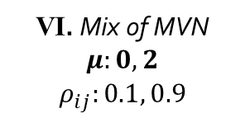
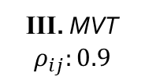
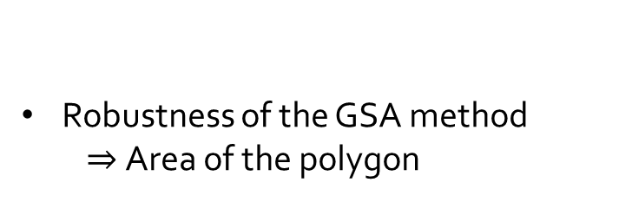


Power Performance
VI. Mix of MVN
$$μ:0, 2$$
$$ρ_{ij}:0.1, 0.9$$
$$Δ=\left(N_{0}:12, N_{0.5}:18\right),…$$
Mean of elements in 𝚫: 0.3 Variance of elements in 𝚫: 0.0621
Axis: Scenario (III, IV, VI)
Hotelling's T² is dominating under this difference vector structure (Mahalanobis distance).
Power
III. MVT
$$ρ_{ij}:0.9$$
IV. Mix of MVN
$$μ:0, 0$$
$$ρ_{ij}:0.1, 0.9$$
Robustness of the GSA method
$⇒$Area of the polygon

Slide 23
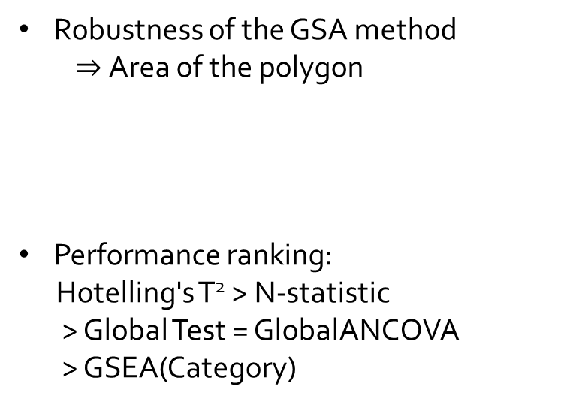
Power Performance
VI. Mix of MVN
$$μ:0, 2$$
$$ρ_{ij}:0.1, 0.9$$
Robustness of the GSA method
$⇒$Area of the polygon
Performance ranking:
Hotelling's T² > N-statistic
> Global Test = GlobalANCOVA
> GSEA(Category)
Power
III. MVT
$$ρ_{ij}:0.9$$
IV. Mix of MVN
$$μ:0, 0$$
$$ρ_{ij}:0.1, 0.9$$

Slide 24
Summary & Discussion

Slide 25
Summary
Non-normality of real data
Pathway for diseases
Four normality tests
Data is unlikely normally (log-normally) distributed.
Evaluation Methods
Non-normal scenarios
MVT
Mixture distributions
Two types of difference vector structure
Five GSA methods
Robustness

Slide 26
Summary
Evaluation Results:
Hotelling’s T² performs the best
Most of the GSA methods perform poorly under the non-normal scenarios
Three elements in our evaluation method are important:
Correlations between genes
Choice of scenarios
Structure of difference vector
Some advice for researchers to develop GSA methods:
Distribution-free methods
Binary phenotypes: Multivariate distance of the data

Slide 27
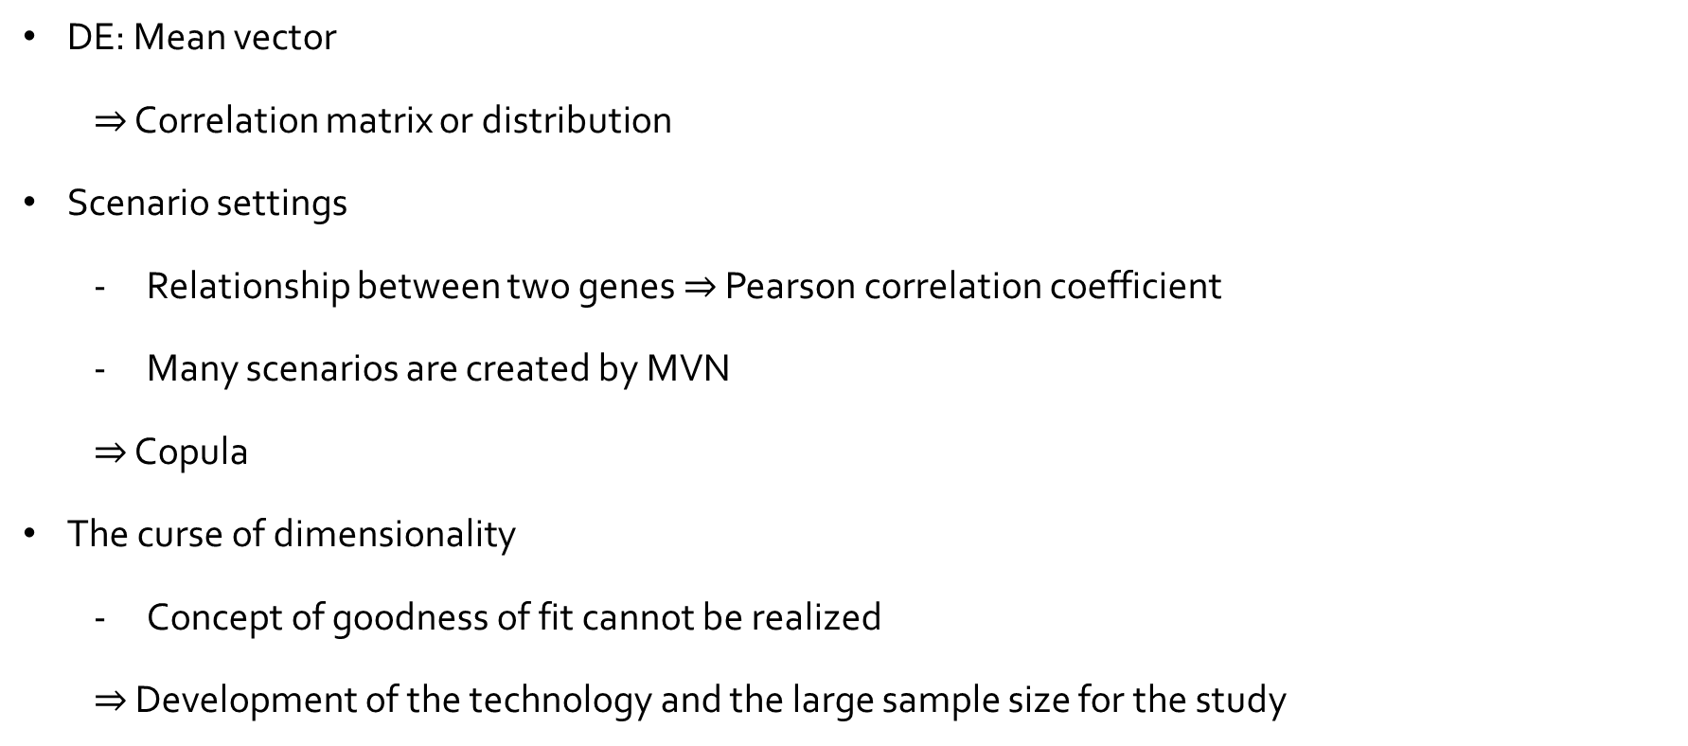
Discussion
DE: Mean vector
$⇒$ Correlation matrix or distribution
Scenario settings
Relationship between two genes $⇒$ Pearson correlation coefficient
Many scenarios are created by MVN
$⇒$ Copula
The curse of dimensionality
Concept of goodness of fit cannot be realized
$⇒$ Development of the technology and the large sample size for the study

Slide 28
THANK YOU

Slide 29
Reference

Slide 30
p5
MVN: (Glazko, and Emmert-Streib 2009; Goeman, and Bühlmann 2007; Ackermann, and Strimmer 2009; Hummel, Meister, and Mansmann 2007; Kim, and Volsky 2005; Liu et al. 2007; Song, and Black 2008)
LogMVN: (Qiu,and Yakovlev 2006; Klebanov et al. 2007)
Real Data: (Nettleton, Recknor, and Reecy 2008; Heller et al. 2009; Liang, and Nettleton 2010; Benidt, and Nettleton 2015)
p9
Mardia: (Korkmaz, Goksuluk, and Zararsiz 2014)
HZ: (Korkmaz, Goksuluk, and Zararsiz 2014; Henze, and Zirkler 1990)
Royston: (Korkmaz, Goksuluk, and Zararsiz 2014)
One-sample energy: (Székely, and Rizzo 2005)

Slide 31
p17
Hotelling’s T²: (Hotelling’s T2 (Lu et al. 2005; Schäfer, and Strimmer 2005)
The Global test: (Goeman et al. 2003)
The GlobalANCOVA: (Hummel, Meister, and Mansmann 2007)
Energy Test (N-statistic): (Székely, and Rizzo 2004; Klebanov et al. 2007; Baringhaus, and Franz 2004)
GSEA (Category): (Gentleman, Morgan, and Huber 2008)
p25
Copula: (Sklar 1959)

Slide 32
Appendix

Slide 33
The Non-normality of Real Data
Data processing
Breast
Colorectal
Quantile Normalization
Raw Data (NCBI GEO/TCGA)
RMA (Robust Multi-array Average)
Disease-related Pathways Data Selection (GSA)
Homogeneous Clinical Data Management
Lung A
Lung B
Leukemia
Ovarian
CS/ADJ
Size: 13
Pathway: 2
PI3K-AKT
Wnt
CS/ADJ
Size: 11
Pathway: 5
Wnt
RAS
PI3K-AKT
P53
TGF-$β$
CS/ADJ
Size: 21
Pathway: 7
MAPK
Wnt
Cell cycle
mTOR
P53
EGFR
JAK-STAT
CS/ADJ
Size: 47
Pathway: 7
MAPK
Wnt
Cell cycle
mTOR
P53
EGFR
JAK-STAT
CS/CN
Size: 19/10
Pathway: 4
PI3K-Akt
mTOR
JAK-STAT
Wnt signaling
CS/CN
Size:47/116
Pathway: 4
PI3K-Akt
mTOR
Jak-STAT
p53

Slide 34
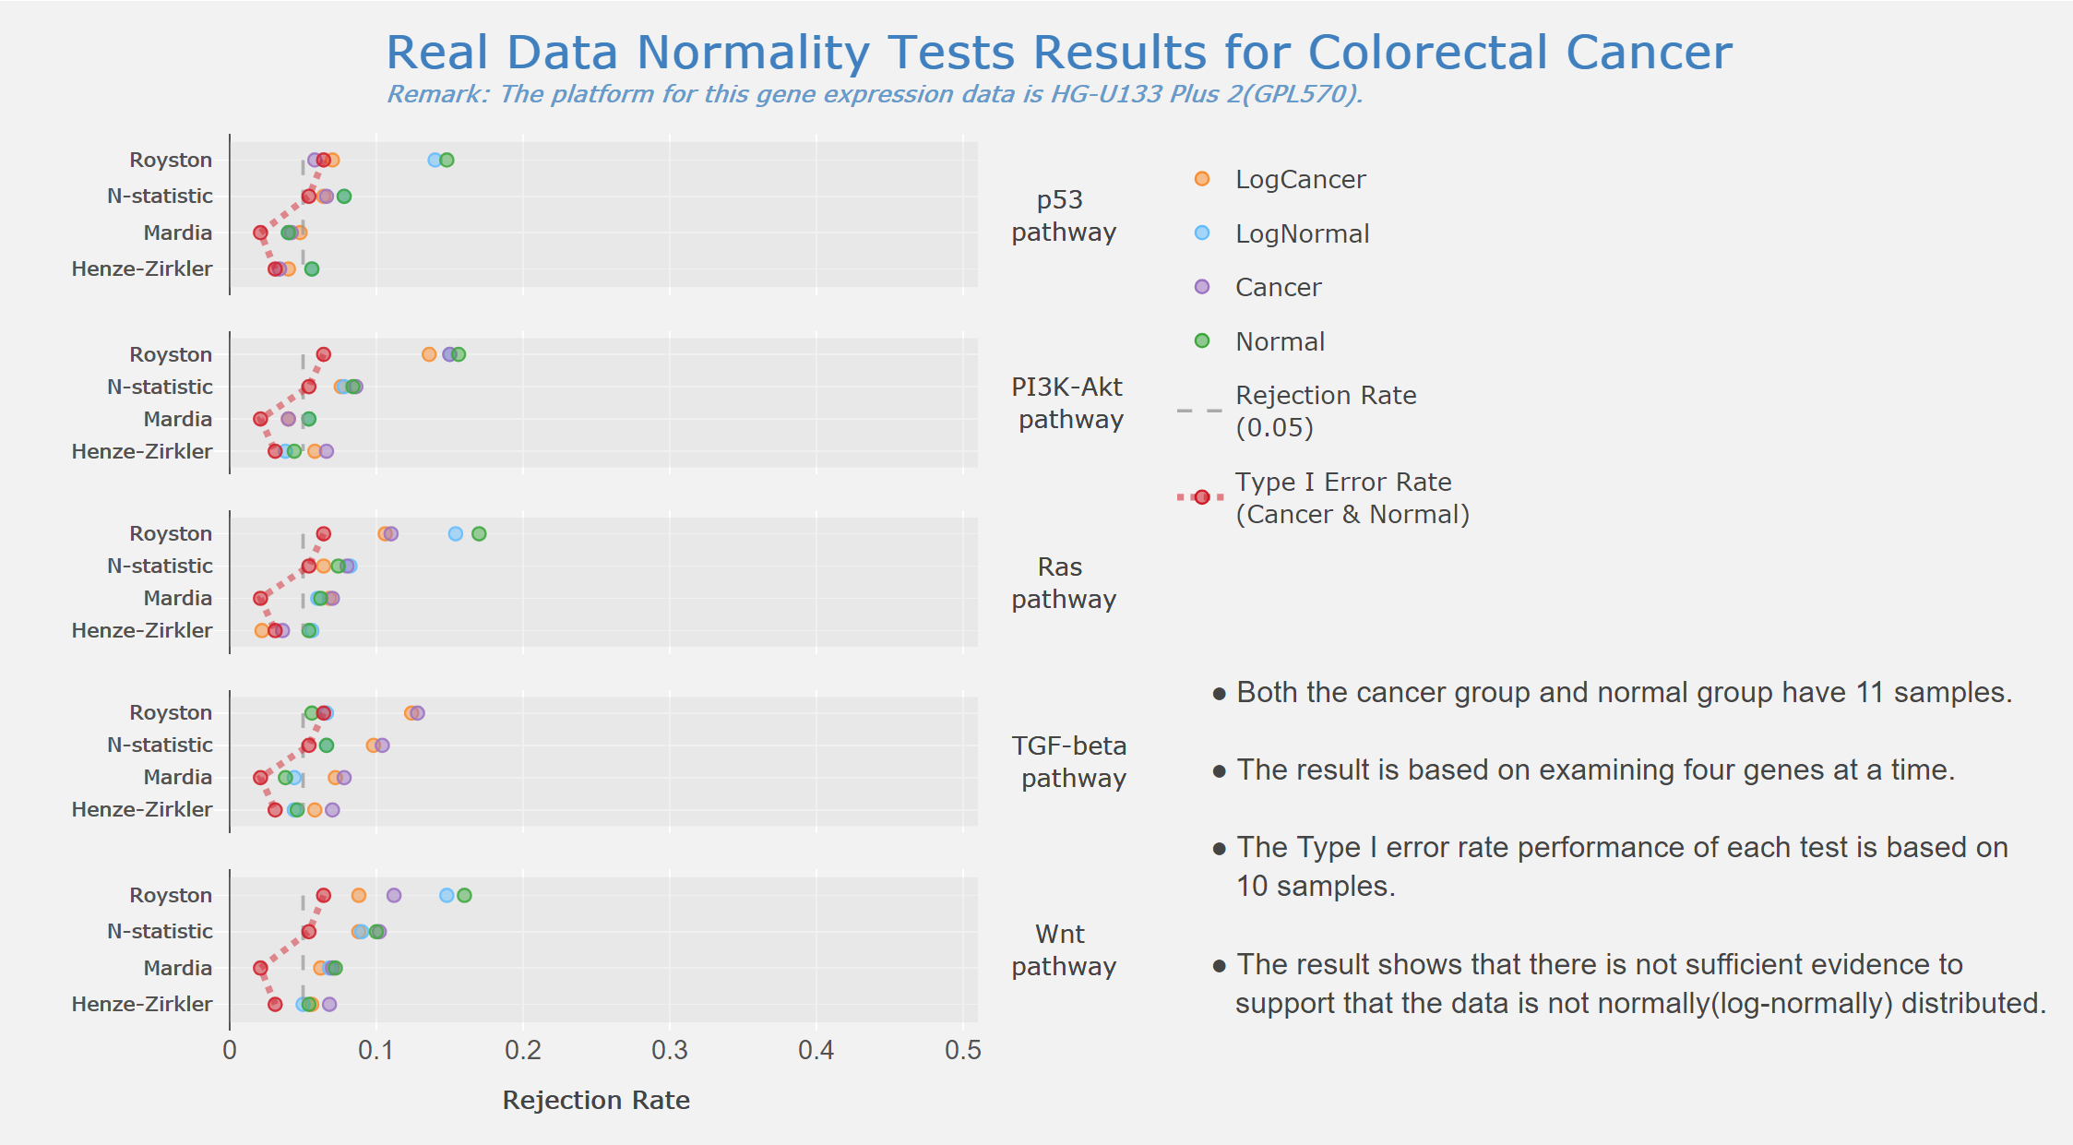
The Non-normality of Real Data
Dataset | Breast | Colorectal | Lung A | Lung B | Leukemia
Type I error rate | 0.047 | 0.047 | 0.05 | 0.056 | 0.05
Pathway | PI3K/AKT | TGF-𝛽 | Cell cycle | Cell cycle | JAK/STAT3
Rejection rate(O) | 0.118 | 0.104 | 0.698 | 0.862 | 0.384
Rejection rate(log₂) |  |  |  | 0.796
Sample size | 13 | 11 | 21 | 47 | 19

Slide 35
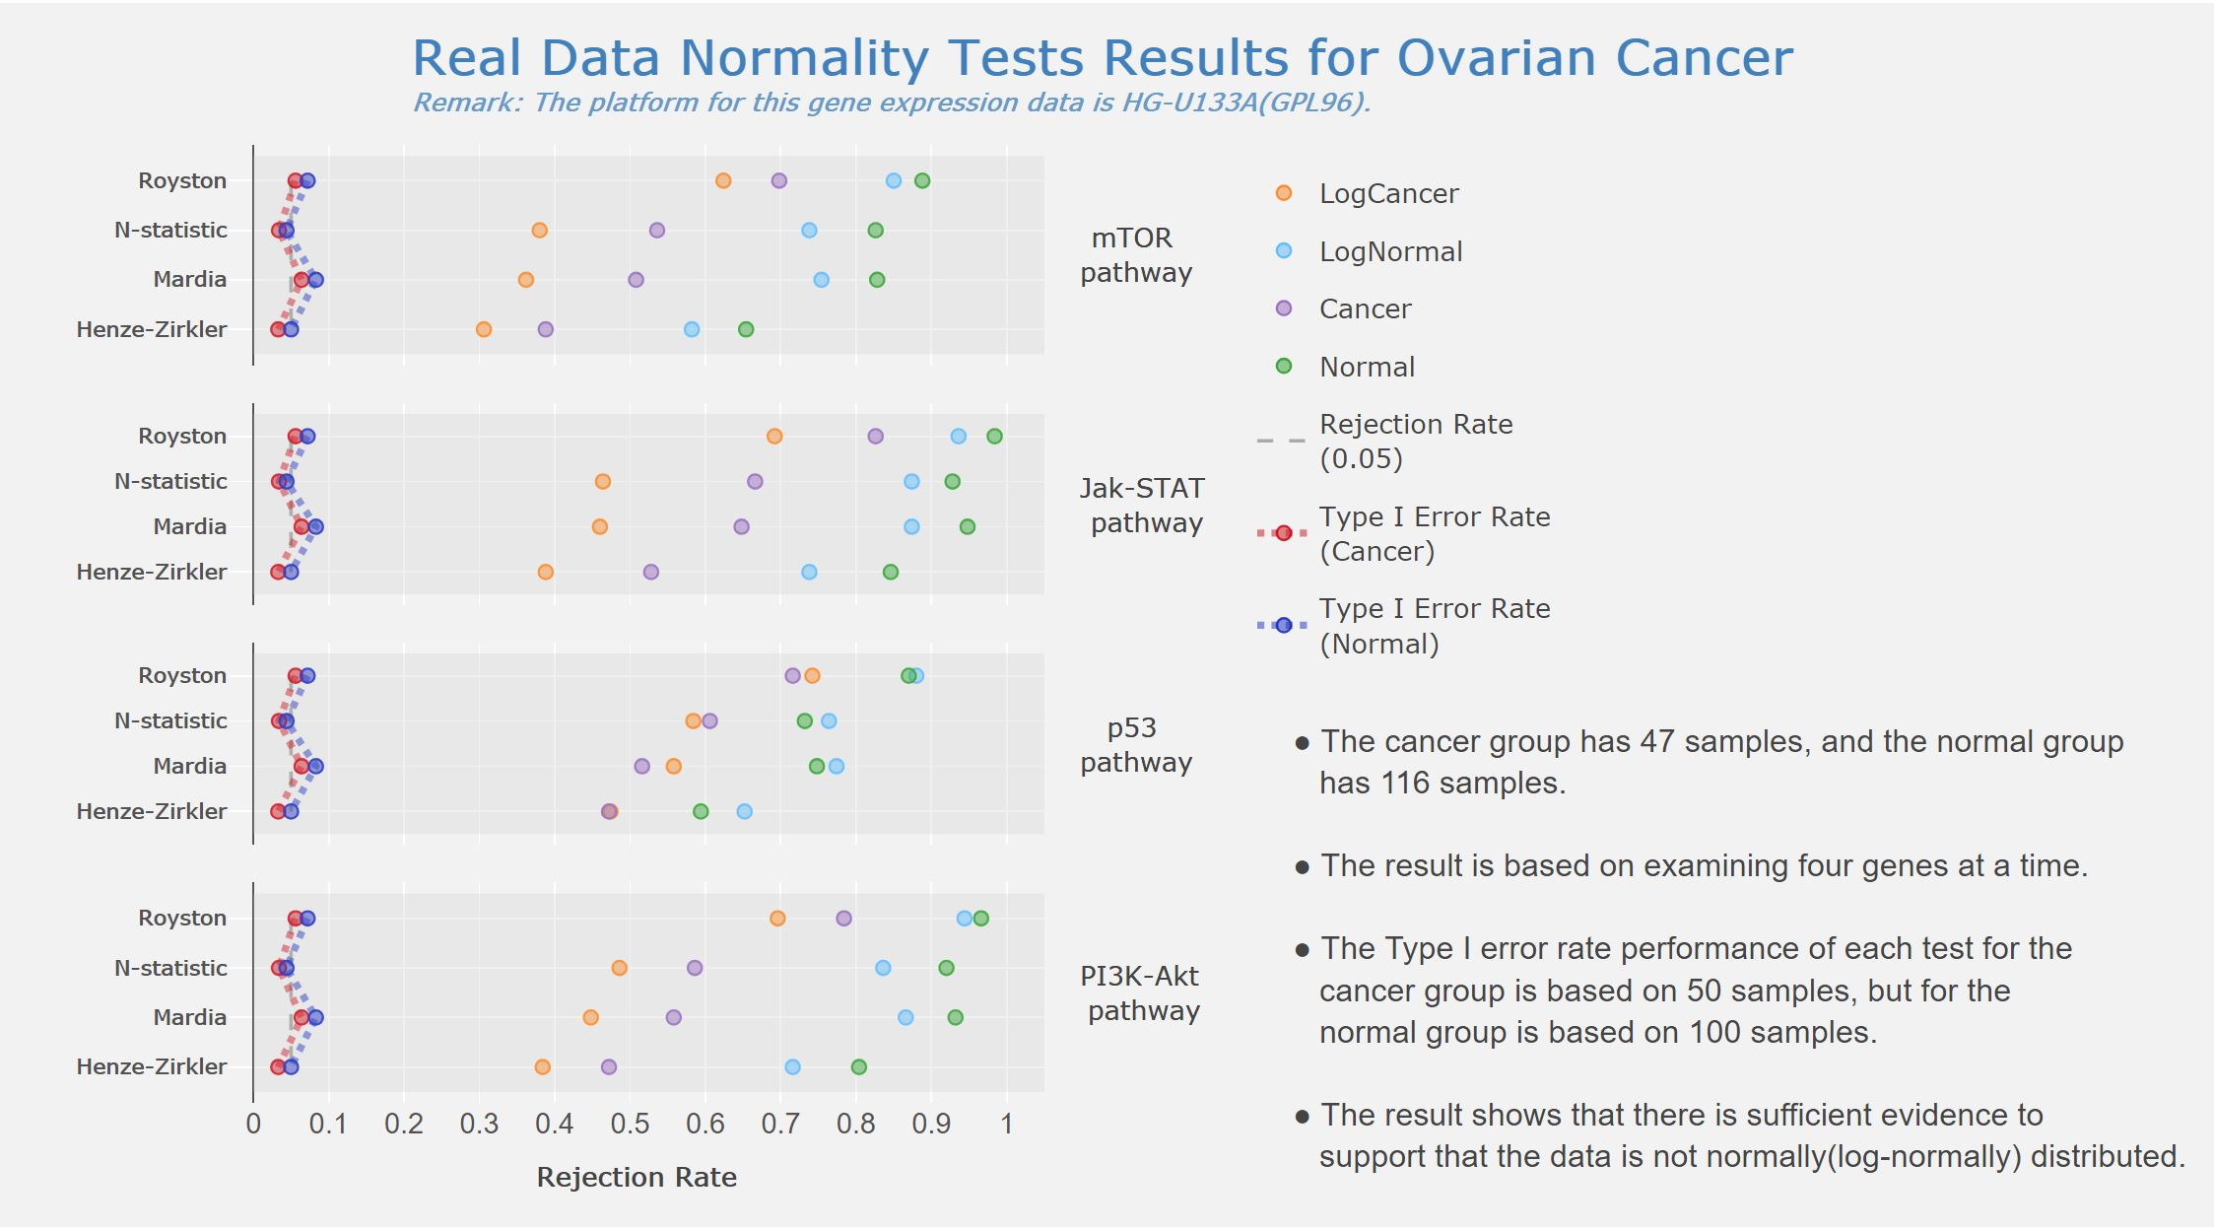
The Non-normality of Real Data
Dataset | Breast | Colorectal | Lung A | Lung B | Leukemia
Type I error rate | 0.047 | 0.047 | 0.05 | 0.056 | 0.05
Pathway | PI3K/AKT | TGF-𝛽 | Cell cycle | Cell cycle | JAK/STAT3
Rejection rate(O) | 0.118 | 0.104 | 0.698 | 0.862 | 0.384
Rejection rate(log₂) |  |  |  | 0.796
Sample size | 13 | 11 | 21 | 47 | 19

Slide 36
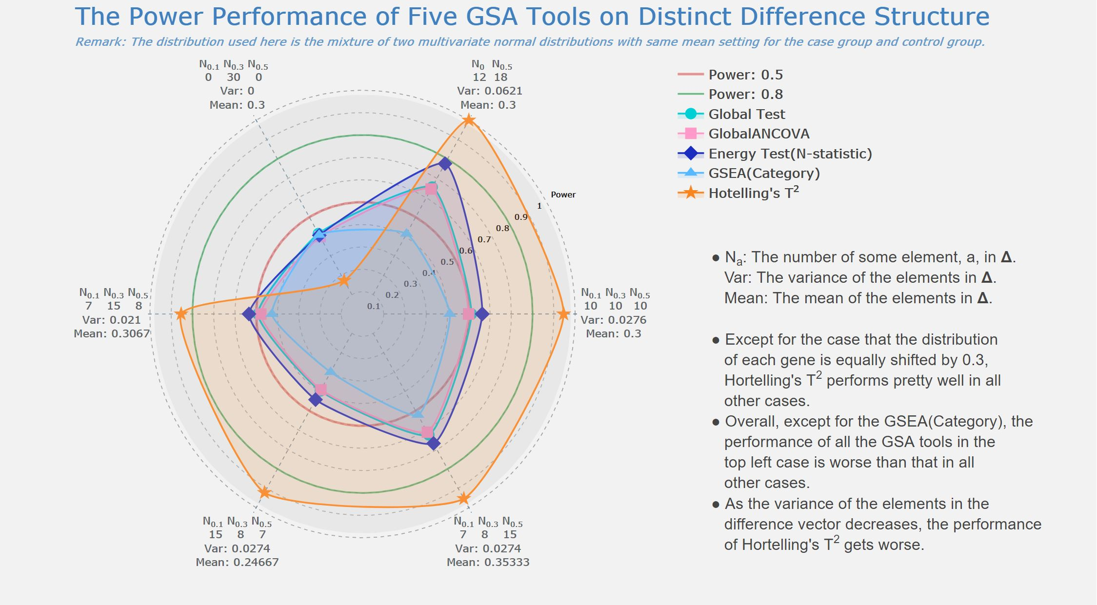
Scenario IV
+
B.
INTRODUCTION
MEASUREMENT
IMPROVEMENT
VERIFICATION
GOAL

Slide 37
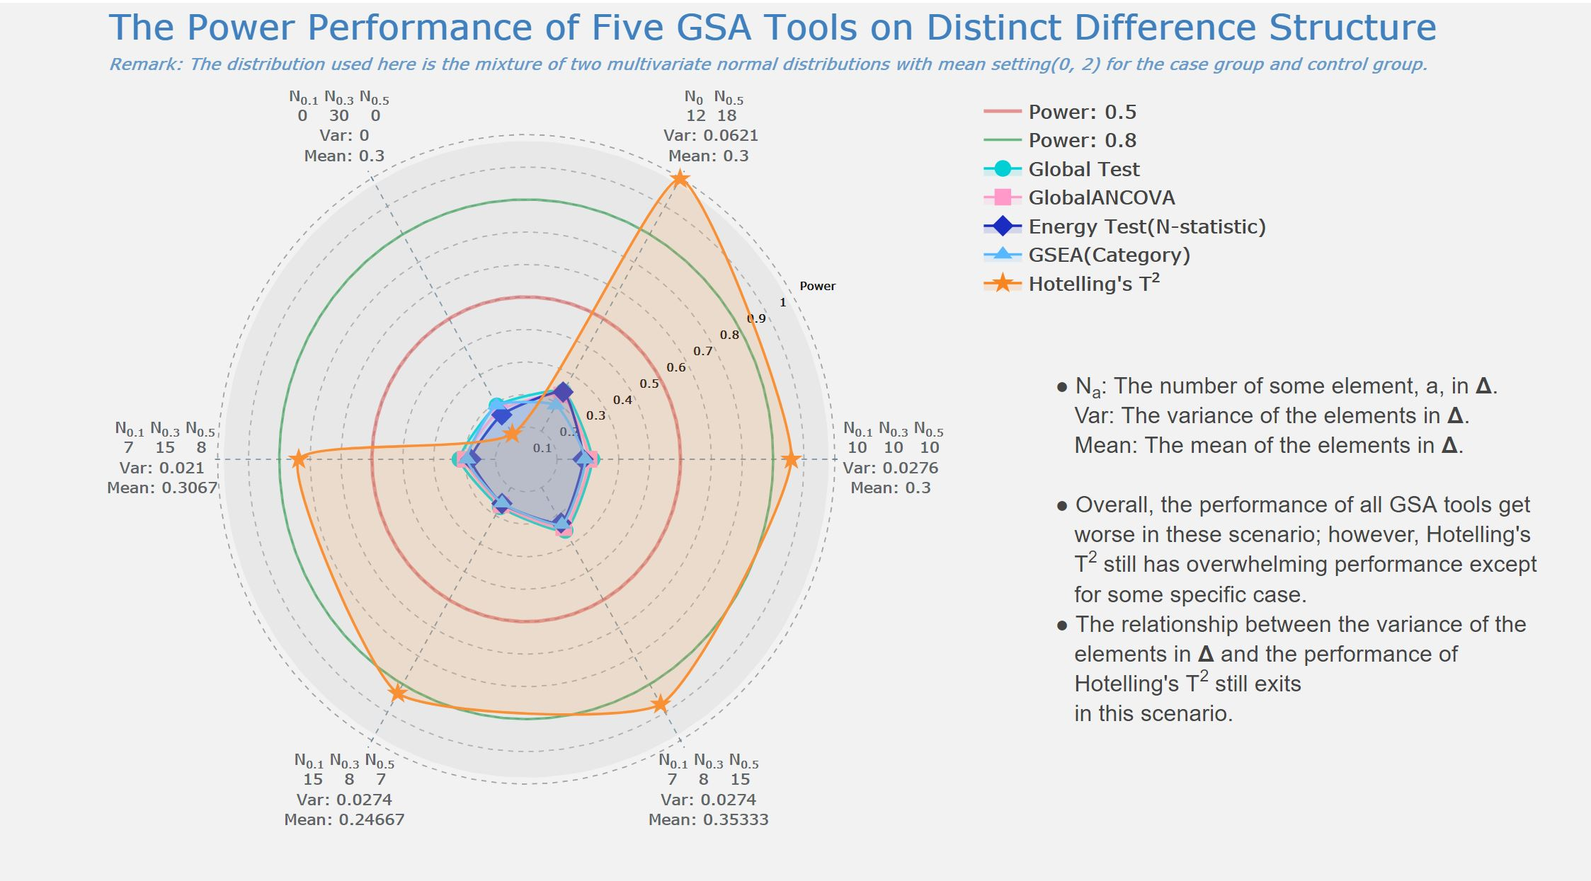
Scenario VI
+
B.
INTRODUCTION
MEASUREMENT
IMPROVEMENT
VERIFICATION
GOAL

Slide 38

Scenario III
+
B.
INTRODUCTION
MEASUREMENT
IMPROVEMENT
VERIFICATION
GOAL

